Slide 1
Ruth Gonzalez PCAC
Potomac Conference TLT Convention Oct 2018
Pecometh

Slide 2
Traveling?
Why
When
Where
What
Who
How

Slide 3
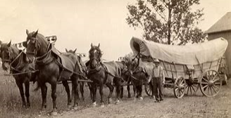
TRAVEL/VIAJES Instructor: Ruth Gonzalez October 2018

Slide 5
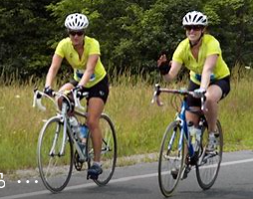
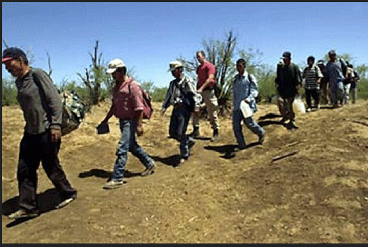

Slide 6
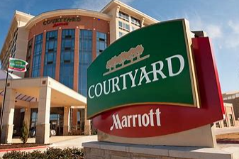
LODGING/HOSPEDAJE

Slide 10
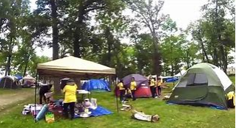

Slide 11
Documents needed/Documentos importantes
Drivers License / Licencia
Passaport
Visa
Birth certificate/Certificado de Nacimiento
Marriage Certificate/ Certificado de matrimonio
Permisos/Permision slips
Records medicos/Allergies

Slide 12
Attitude/Actitud
Respeto al pais/Respect for the locals
Respeto a la religion/Respect for religion
Expect the unexpected
Las cosas no son como en casa/ This is not home
Learn some of the language
Come local
Comomunicate con los locales

Slide 13
How to pack a suit case
10 travel savety tips

Slide 14
https://www.youtube.com/watch?v=LIk8v__Osm8

Slide 17
Emergency plan
Who
When
Documents
Pictures
Mental notes
Authorities
Getting back home

Slide 18
