Slide 1
Christian Citizenship

Slide 2
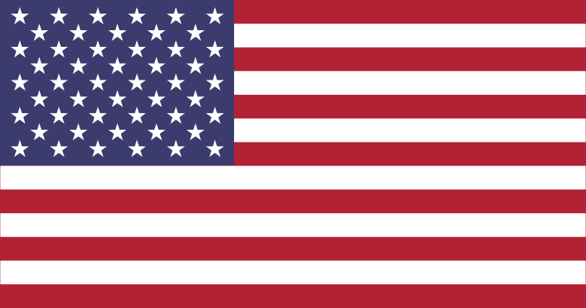
Describe the Flag of the United States of America
The U.S. Flag has 13 equal horizontal stripes of red (top and bottom) alternating with white; there is a blue rectangle in the upper hoist-side corner bearing 50 small, white, five-pointed stars arranged in nine offset horizontal rows of six stars (top and bottom) alternating with rows of five stars; the 50 stars represent the 50 states, the 13 stripes represent the 13 original colonies; known as Old Glory

Slide 3
Describe the Flag of the State of Maryland
The Maryland Flag is black, gold and red. The design is the design of the coat of arms of Sir. George Calvert, the first Lord Baltimore. The vertical bars approximate the bars of the palisade.

Slide 4
Describe the AY Flag
The background is red and white, red. Red symbolizes the blood of Christ. White represents purity. In the center, there is a logo that has AY which means Adventist Youth and it has three angels meaning the 3 Angels Message.

Slide 5
Describe the Christian Flag
The "Christian Flag" is a white flag with a blue canton and a red cross in it. It was designed by Charles Overton in 1897 to represent Protestants of all denominations. The cross symbolizes the crucifixion of Christ.

Slide 6
When marching in a parade, there is only one flag that has guidelines as to its location. That flag is the U.S. flag.
When marching with only one row of flags, the U.S. flag is always on the right end of the row (that is as viewed from the column following behind the flags).
When marching with multiple rows of flags, the U.S. flag is always to be in the front row. The U.S. flag is also alone in the first row. The U.S. flag will be in the front row leading the column from the center position of the row.
The U.S. flag should never be dipped as a sign of respect to a dignitary. The Pathfinder flag, AY flag, Christian flag and state flags are dipped when the "eyes right" command is given, but the U.S. flag should be held vertically.
Know how to display the US flag with two other flags in a Parade.

Slide 7
The flag of the United States of America should be at the center and at the highest point of the group when more than one flag is grouped and displayed from staffs.
When flags of two or more nations are displayed, they are to be flown from separate staffs of the same height. The flags should be of approximately equal size. International usage forbids the display of the flag of one nation above that of another nation in time of peace. The order of precedence for flags generally is National flags (US first, then others in alphabetical order in English).
When marching with multiple rows of flags, the U.S. flag is always to be in the front row. The U.S. flag is also alone in the first row. The U.S. flag will be in the front row leading the column from the center position of the row.
State (host state first, then others in the order of admission) and territories (Washington DC, Puerto Rico, etc.)
Know how to display the US flag at a Camp out/camporee.

Slide 8
Demonstrate how to fold your national flag.
Have two people stand on either end of the flag, holding a corner in each hand.
Fold the flag in half twice, length-wise.
Beginning at the striped end, fold one corner into the opposite side of the flag, forming a triangle.
Repeat this triangular folding until only a small strip of the star field shows.
Tuck this strip into the triangle.

Slide 9
Other Rules about the US Flag - Hanging
When flown horizontally, as from a flagpole, the flag should be oriented so that the canton is closest to the top of the pole. If hung against a wall, the canton should be placed in the upper-left corner from the point of view of the observer.
When hung vertically, flags should be rotated so the canton is against the closest to the tope of the pole. If the flag is displayed against a wall, the canton should again appear in the upper-left corner, which incidentally required that the flag be both rotated and flipped from its horizontal position.

Slide 10
Other Rules about the US Flag – Other Places
On a vehicle the flag should be affixed securely to the front right of the chassis.
When placed with a podium or at a place of worship the flag should be hang directly behind or on a pole to the right of the speaker, from the point of view of the audience.
When carried in single file the flag of honor leads.

Slide 11
Explain the meaning of and reason for the National Anthem, and recite the words from memory
The National Anthem of the United States of America is 'The Star-Spangled Banner'. The words were written on September 14 1814, on board a British frigate in Baltimore harbor, where the author, Francis Scott Key (1779-1843) had been detained after successfully petitioning for the release of a civilian friend. He was inspired to write the poem when he saw in the morning, the American flag still flying over Fort McHenry, which had withstood the British bombardment during the previous night. It has 4 verses and all of them end in “O’er the land of the free and the home of the brave!”, meaning that America was built on the aspects of freedom and independence.
The Star Spangled Banner
O say, can you see, by the dawn’s early light,
What so proudly we hailed at the twilight’s last gleaming,
Whose broad stripes and bright stars, through the perilous fight,
O’er the ramparts we watched, were so gallantly streaming?
And the rockets’ red glare, the bombs bursting in air,
Gave proof through the night that our flag was still there;
O say, does that star-spangled banner yet wave
O’er the land of the free and the home of the brave?

Slide 12
Give the Rights a citizen of our country has.
United States' citizens have the right to fully participate in the political system of the United States (with most member states having restrictions for felons, and a federal restriction on naturalized persons running for President and Vice President of the United States), are represented and protected abroad by the United States (through U.S. embassies and consulates), and are allowed to reside in the United States, and certain territories, without any immigration requirements. Here are some of the rights you have as a U.S. citizen:
Freedom of Religion
Freedom of Assembly
To Keep and Bear Arms
Freedom of Speech
Freedom of the Press
Protection for those Accused of Crimes

Slide 13
Give the Responsibilities a citizen of our country has.
Citizens have the duty to serve in a jury, if selected.
Citizens are also required to pay taxes on their total income from all sources worldwide, including income earned while residing abroad (regardless of the duration of the residence)
The United States Government also insists that U.S. citizens travel into and out of the United States on a U.S. passport, regardless of any other nationality they may possess.
Male U.S. citizens (including those living permanently abroad and/or with dual U.S./other citizenship) are required to register with the Selective Service System at age 18 for possible conscription into the armed forces. Although no one has been drafted in the U.S. since 1973, draft registration continues as a standby contingency measure in the event Congress were to decide to reinstitute conscription at some future date.
Also, citizens are encouraged to vote, but it is not required.

