Slide 1
Découpage
(ooh la la!)

Slide 2
What is it?
Decoupage - from french word
"decouper" ("to cut")
Paper cut-outs are glued onto an object to decorate it
Every layer is sealed with varnish (traditionally 30-40 layers)

Slide 3
Where did it come from?
Originated in Florence, Italy (1700s)
- mostly furniture (also boxes,frames, plaques)
- Combined decoupage with other techniques (gilt, wood carving)
- Inspired by Chinese lacquer boxes - tried to imitate this process on furniture
- lacca contrafatta, italian for 'counterfeit lacquer'

Slide 4
Chinese Export Lacquer Sewing Box, circa 1850.
Florentine style box (decoupage), 1800s

Slide 5
Poor man's art
Italians started using copies of fashion designs and popular artwork, instead of copying Chinese designs. Became known as "poor man's art"
Household items could be used to make something beautiful...
... newspapers, magazines, catalogs, books, printed clip art, wrapping paper, greeting cards, fabric, tissue paper, lace.

Slide 7
Materials and Equipment Needed in Découpage
Something to decoupage on:
Wood
Tile
A Box,
Picture Frames
Furniture
Photo Albums
Plates
Ceramics
Shelving
Mirrors

Slide 8
Materials and Equipment Needed in Découpage
Something to decoupage with (cut up):
Pictures
Wrapping Paper
Fabric
Tissue Paper
Napkins
Lace
Pressed Flowers
Anything Flat
Equipment Needed:
Scissors
Glue
Paint Brush
Sealer – More Glue or Varnish
Sandpaper

Slide 9
Steps to Decoupage a Bookmark
Make sure the object (bookmark) is clean and smooth
The bookmark we have is already smooth, but if it wasn’t you would need to sand it down and then clean it off to make sure the surface is clean and smooth.

Slide 10
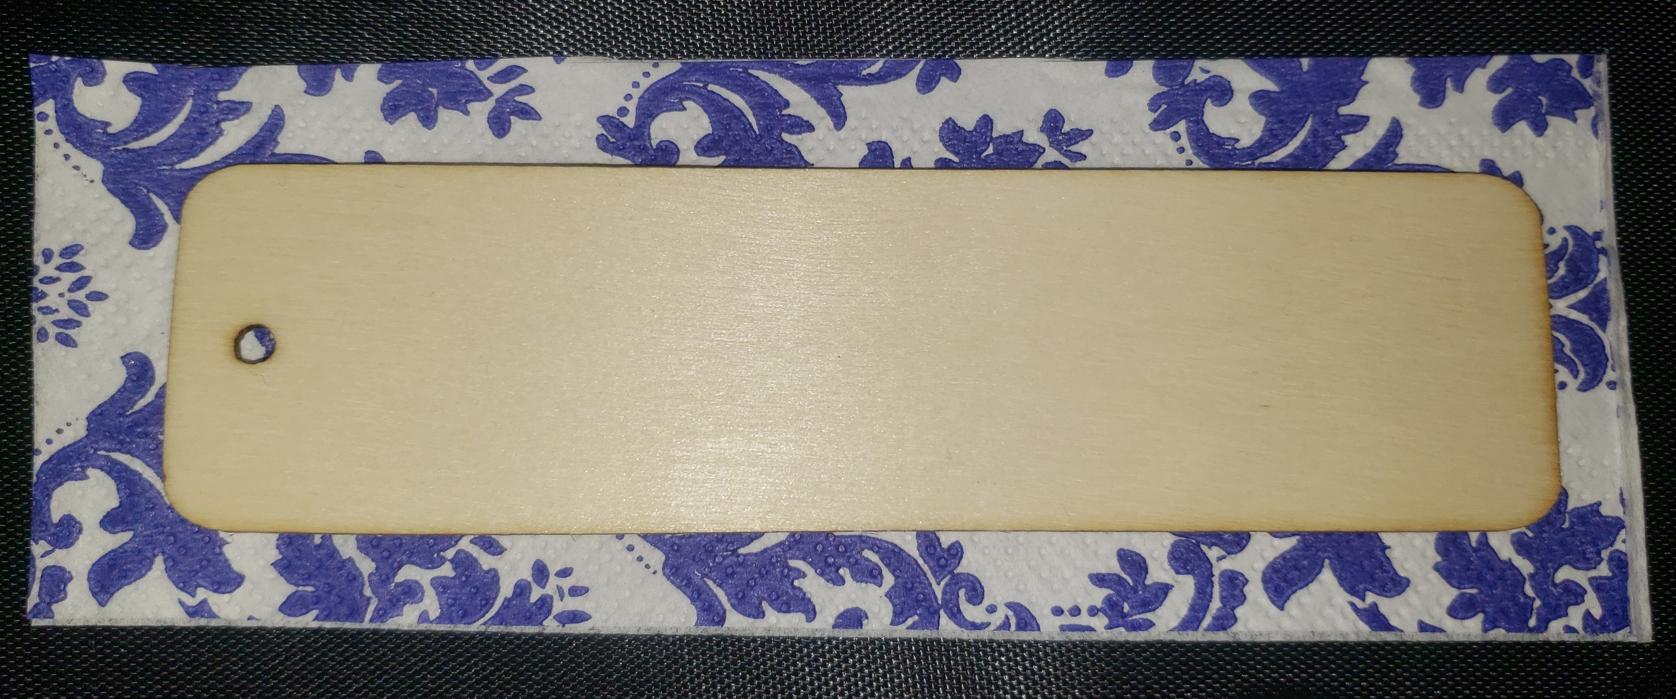
Steps to Decoupage a Bookmark
Next: Cut your decoration, making sure it is a little bit bigger than the bookmark.

Slide 11
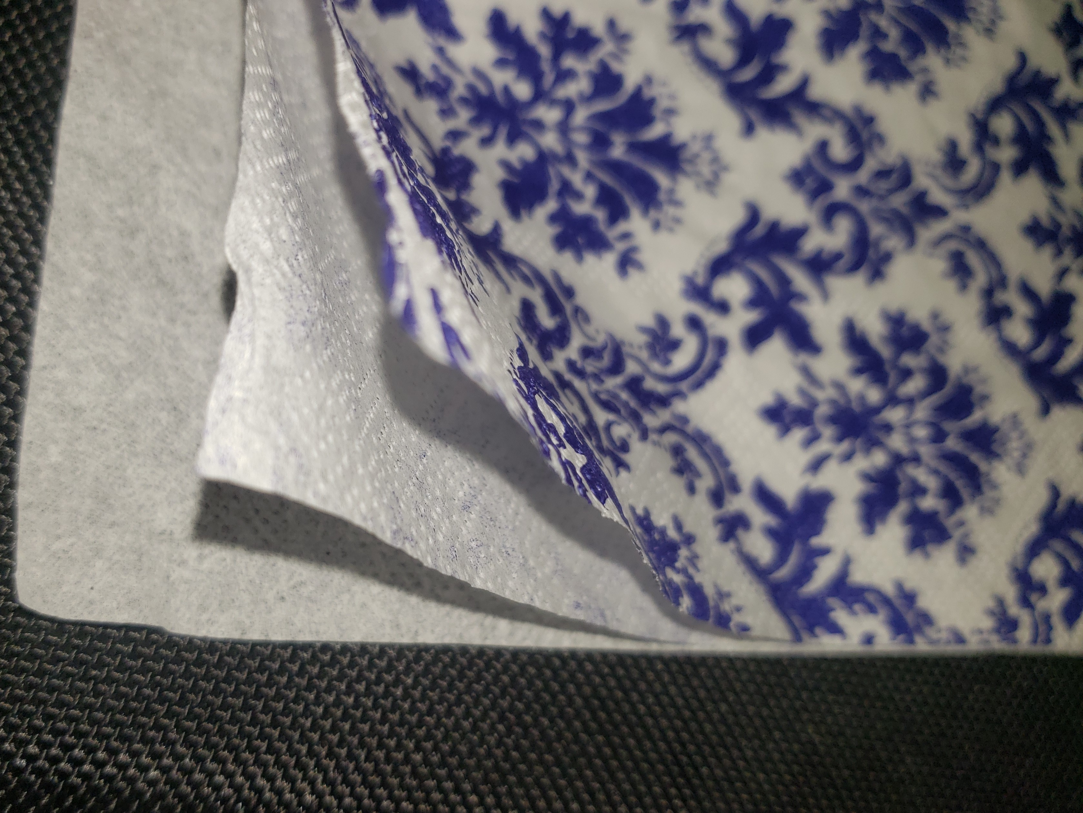
Steps to Decoupage a Bookmark
Next: Split the napkin apart
This particular napkin has three layers. You only want to keep the top layer with the design. You can throw the other layers away. Some napkins may only have two layers.

Slide 12
Steps to Decoupage a Bookmark
Next: Next put a layer of glue on the bookmark.

Slide 13
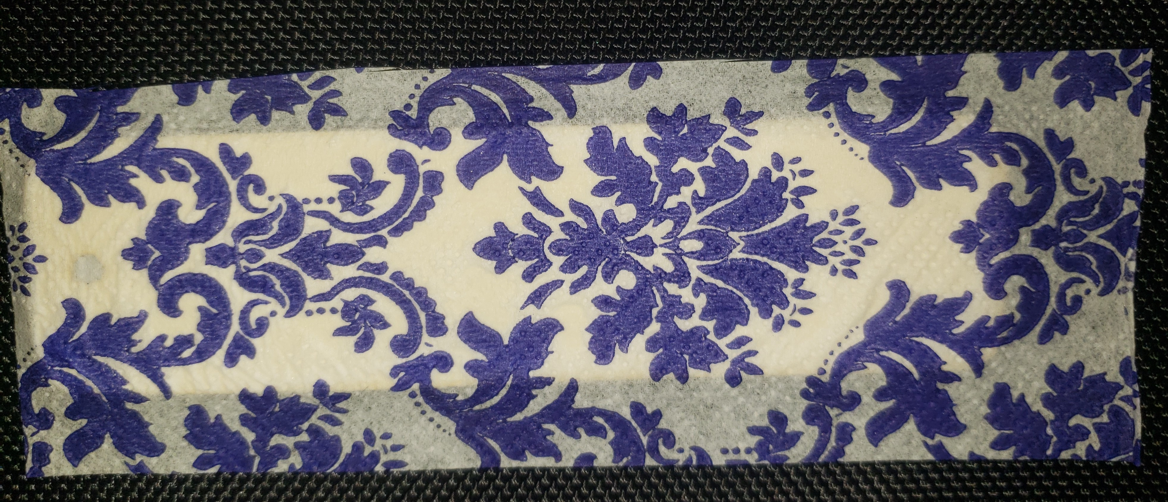
Steps to Decoupage a Bookmark
Then put the napkin on top of the glue covered bookmark.

Slide 14
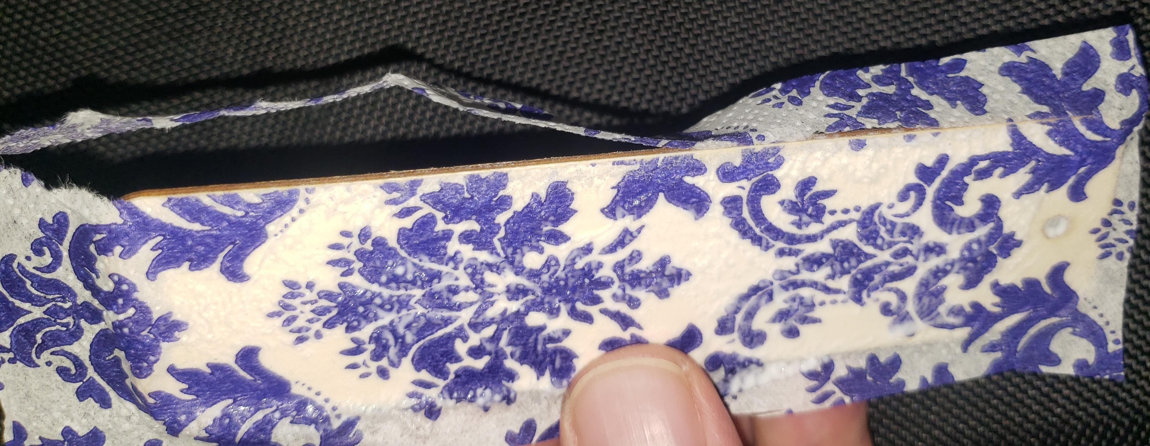
Steps to Decoupage a Bookmark
Now carefully sand the edges. I bent the paper and held it from behind then sanded the edge.

Slide 15
Steps to Decoupage a Bookmark
Finally add a layer of glue to the top and let it dry.
When it is dry you can punch out the whole with a pencil and add the twine. Once it is dry you can also decoupage the back side, write a note or otherwise decorate it.

Slide 16
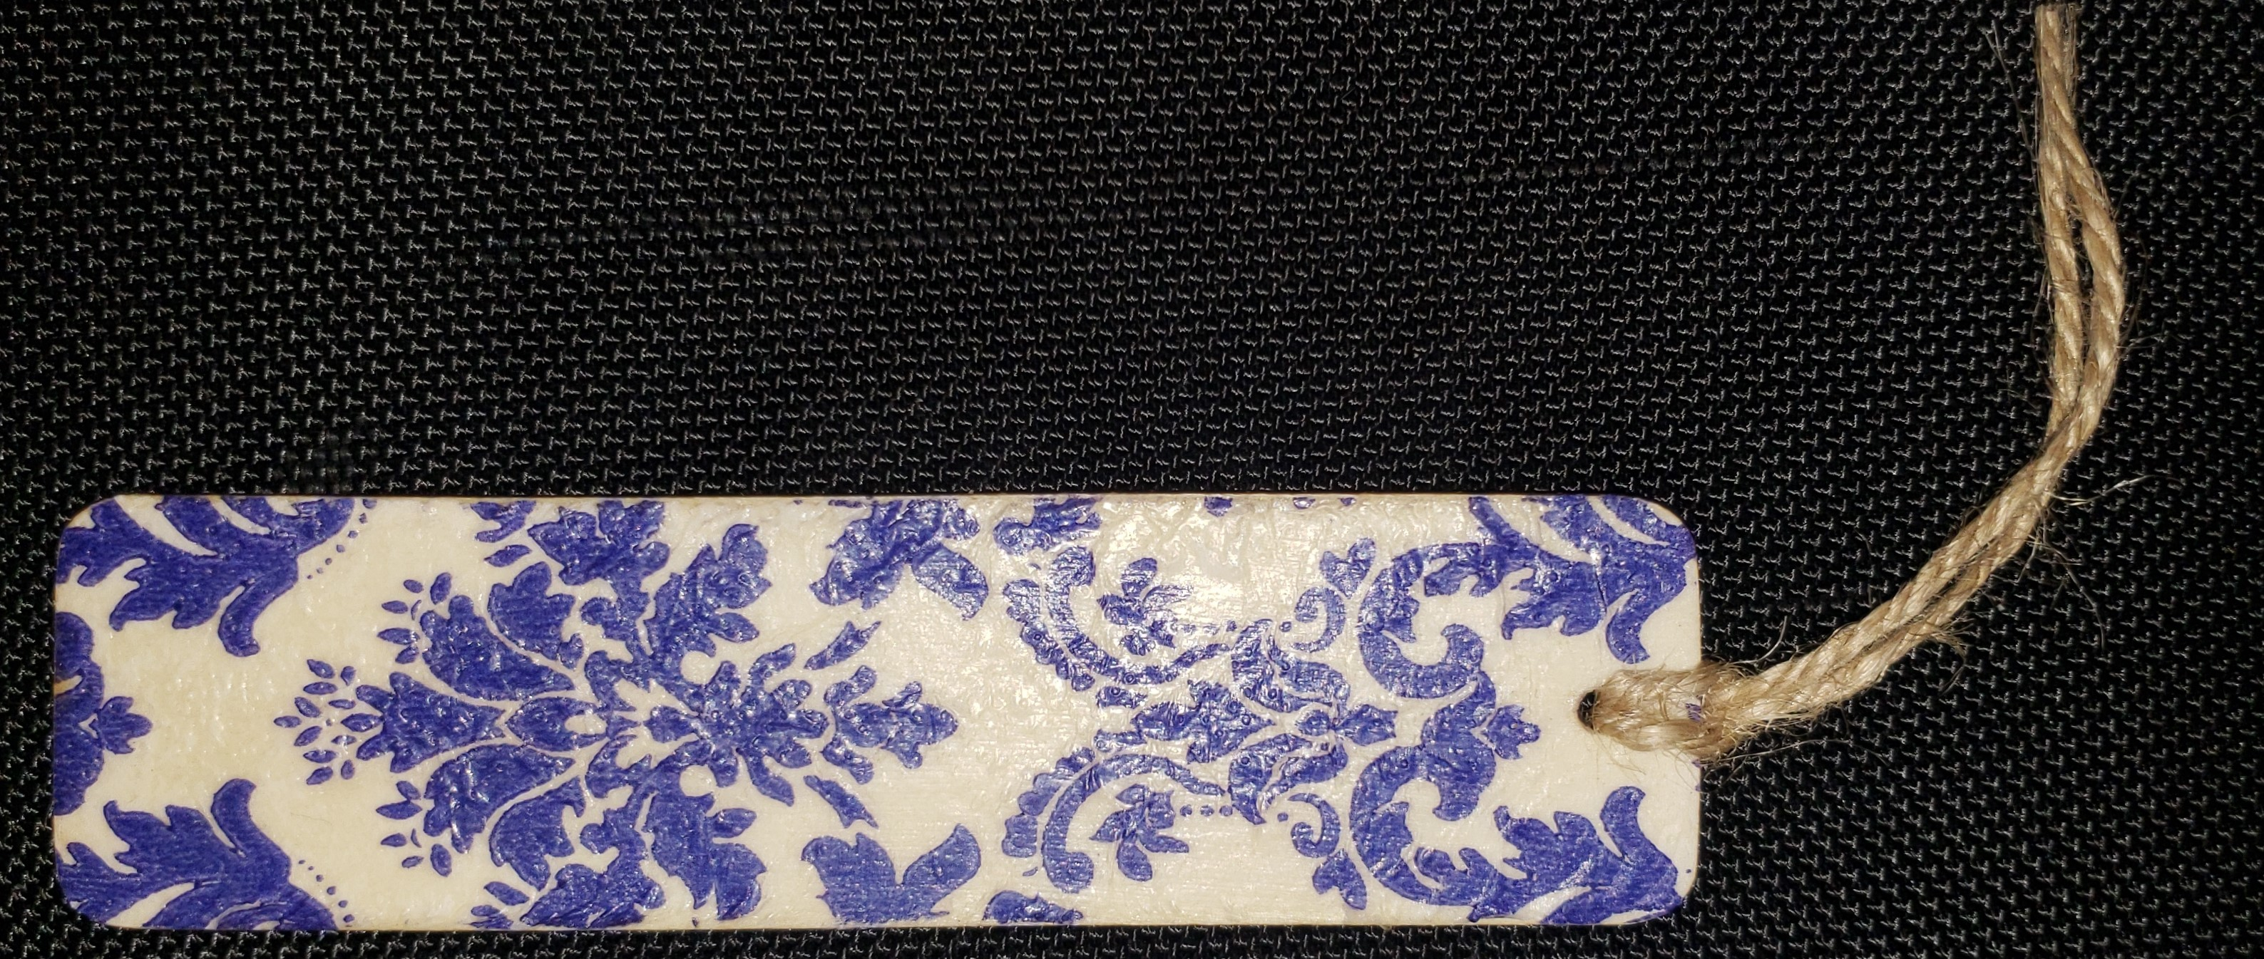
Steps to Decoupage a Bookmark
Finished Bookmark

